Slide 1



FACILITIES MANAGEMENT & LEASING MANAGEMENT SERVICES
Prepared for
Prepared by
Notes:
Speaker: All
Total speaking time in section = 1 min
Speaking time for this slide: 30 secs
Speaker Notes:
Abs to do a quick intro + Thank you

Slide 2
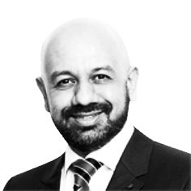


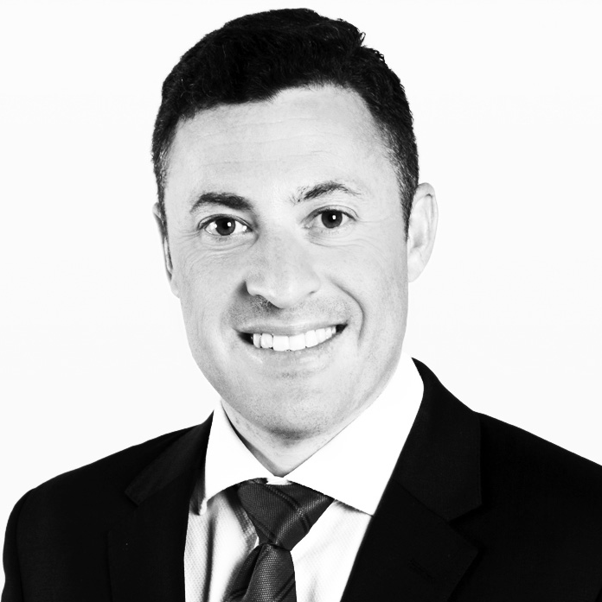
WITH YOU TODAY
Abhishek Bajpai
Managing Director
Corporate Solutions Asia Pacific
Singapore
Chloe Teo
Director
Corporate Solutions Asia Pacific
Singapore
Wei Leng Tang
Managing Director
Colliers International Singapore
Singapore
Rick Thomas
Executive Director & Head
Occupier Services Singapore
Singapore

Slide 3



AGENDA
01
02
03
Introduction
Overview
of Proposal
Q&A

Slide 4
MEETING DBS’ NEEDS
DBS OBJECTIVES
Integrated technology and data-driven insights.
Competitive advantage through futurology.
Strategic focus through simplification and speed.
Reduced total cost of occupancy & efficient capital.
Increased customer satisfaction.
Global consistency, compliance & risk mitigation.
OUR TEAM & CULTURE
TECHNOLOGY
CONSULTING-LED APPROACH TO TM
OUR
STRUCTURE
Experienced in stakeholder management.
Rated by clients as
“Easy to do business with”.
Best in Class Technology platform: Colliers 360.
Automation and efficiency through technology.
Integrated strategy and transaction process.
Heavy focus on pre-transaction strategy at a site and portfolio level.
One P/L.
Consistency of delivery and compliance.

Slide 5

OUR
COMPANY
Our people, knowledge and track record set us apart.
We are a dedicated and reliable team with a proven track record in the market .

Slide 6









COLLIERS REGIONAL AND GLOBAL | CAPABILITY, REACH AND GROWTH
2019 Global
$3.3B USD
Annual revenue
68
Countries
443
Offices
18,700
Professionals
2B
Sqft managed
69,000
Lease & Sale Transactions
2019
Colliers Sweden
(previous affiliate business)
2018
Colliers acquires Ovenia Group, Finland
2018
Colliers
acquires
Sadolin
& Albaek, Copenhagen
2020
Colliers acquires Dougherty, Minneapolis, USA
Colliers acquires Harrison Street Real Estate Capital, Chicago, USA
2018
Colliers acquires SIP Group, China
2019
Colliers acquires Synergy Property Development Services, India
2018
Colliers acquires
Engel & Volker Marin – Taunus GmbH, Germany
2017
Colliers acquires NixAnderson, Australia

Slide 7
COLLIERS REGIONAL AND GLOBAL | CAPABILITY, REACH AND GROWTH
2015 APAC
$410M USD
Annual revenue
16
Countries
60
Offices
3,700
Professionals
57%
Owned vs Franchised
17,420
Lease & Sale Transactions
Top 3 fastest growing real estate providers. YoY growth rate of 18% over the last 5 years.
Top 3 services providers within all local markets across the Asia Pacific.
Colliers owns 70% of all offices.
#1
#2
in Regional Coverage
Colliers operates in 86 offices and more markets in Asia Pacific than any of our competitors.
#1
in Global Coverage Colliers operates in 68 countries across the globe, placing us second the market with our geographical reach.
in Regional Emerging Markets which enables us to directly deliver where our competitors cannot.
2019 APAC
$630M USD
Annual revenue
16
Countries
86
Offices
4,179
Professionals
65%
Owned vs Franchised
26,200
Lease & Sale Transactions
Colliers will
‘own’all work
for DBS.

Slide 8





COLLIERS REGIONAL AND GLOBAL | CAPABILITY, REACH AND GROWTH
LONG TERM KEY STRATEGY AND VISION COMPONENTS
Leadership in major markets
Enhancing Productivity
Leading and Innovating
Be
Experts
Memorable Service
Strategically acquire
FOCUS ON TECHNOLOGY, DIGITALISATION AND INNOVATIONS
Colliers 360
Office Expert
Colliers Mobility Pass
Workflow management
Basking

Slide 9

COLLIERS SINGAPORE | CAPABILITY, REACH AND GROWTH
REVENUE 2016
18m USD
REVENUE 2020
29m USD
Top 3 Corporate Real Estate providers in Singapore.
Focus on Singapore hub:
80% of our regional Asia Executive Board are based in the Singapore office.
Fastest growing.
Heavy investment
in talent acquisition.
44% revenue growth in 4 years.
COLLIERS IS THE PLACE WHERE OUTSTANDING TALENT STAYS, IS GROWN OR COMES DUE TO OUR CULTURE OF FLEXIBILITY, SPEED AND INNOVATION.

